Slide 1
AIM Iron Sharpens Iron 1/2021
Mid Level Training -
Leaders Working with Muslims
The Problem with Q 4:157 -
Isa did NOT die on the cross as the Injil says

Slide 2
Ice Breaker
Play the paper in the cup game
Notes:
This game demonstrates that
1. people do what you do and not what you say
2. We often make things a lot harder for ourselves that it really has to be.
Game
Pay close attention to me. I am going to show you how to play an important game that you all will have to get up and try. It will become important later to remember this simple game.
Put a cup/bowl/rubbish bin down where they can see it.
Go a long way away from it with a ball or crunched up piece of paper and put a line or mark the distance
Causally tell them “There is only one rule to this game.. put the paper/ball into the cup/basket. First one to do it wins!”
Put one hand behind your back and then give it your best shot. Let everone have a go reminding them casually that there is only one rule put it in the cup.

Slide 3
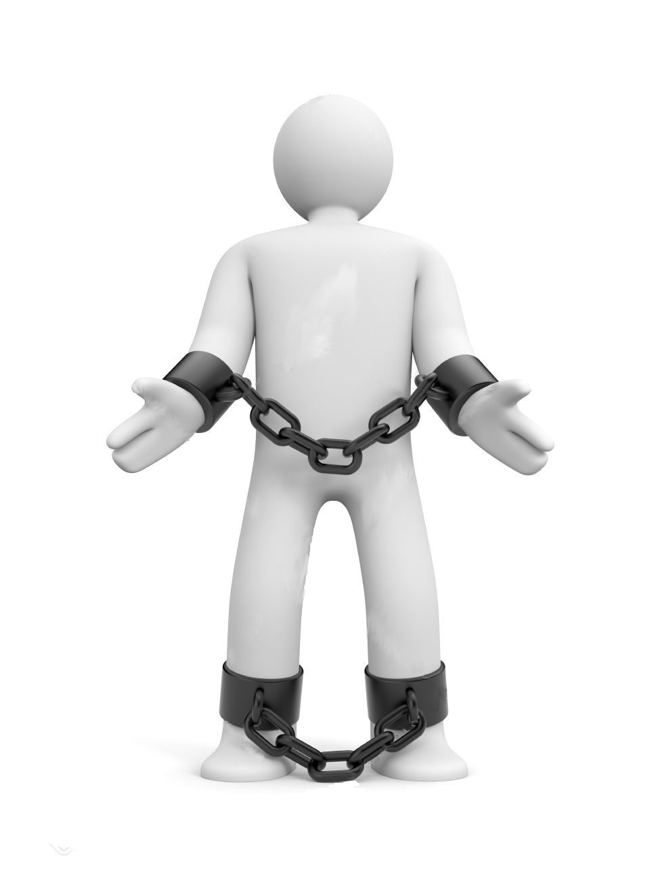
MLT / ISI Housekeeping:
Reminder!!!
How to give disciples information...
Just enough!! and
Just in Time!!
(Coal face) Self Discovery – light burden, fast, heresy of x1
This discussion is NOT to be rolled out to everyone!
If you ever hope to multiply beyond the 4th Generation you have to keep it simple, reproducible & relevant!
The Bible and the Holy Spirit picks up the slack
You are there as a back up. Don’t weigh people down.

Slide 4
Remember!!!
AIM / T4T / CPM is OBEDIENCE based Training
Mid-level Training is more KNOWLEDGE based TEACHING
You have to switch Gears DELIVERING Mid-Level material BUT
CONVERT from Knowledge to OBEDIENCE when trickling down gems that you have picked up from these sessions to your disciples!
(Obedience is small bites, self discovery and become competent before advancing. Knowledge Based Teaching is downloading it whether you understand it or can/will do it.)
Nuff said.mp4

Slide 5
Stop, Think and Smile
Are all your students the same? Are you the same as your wife and kids or friends?
Why do some get things straight up while others seem clueless? Can you use one approach for all people?
Take 10 minutes to do this Simpsons test:
https://www.slideshare.net/lntrullin/the-simpsons-myersbriggs-test
Notes:
Last bit of fluff and stuff to lighten things up before it gets heavy but also very useful discipling tool to help realise that not everyone things the way they do. Culture, age and personality have a lot to do with it.

Slide 6
Q 4:157 (Sahih International):
And [for] their saying, "Indeed, we have killed the Messiah, Jesus, the son of Mary, the messenger of Allah ." And they did not kill him, nor did they crucify him; but [another] was made to resemble him to them. And indeed, those who differ over it are in doubt about it. They have no knowledge of it except the following of assumption. And they did not kill him, for certain.
Remember words in italic or in brackets were added by someone later on and not in the original Arabic.

Slide 7
Watch this video and discuss
Did Jesus die on a cross?
How do you think this relates to 4:157?

Slide 8
Let’s look Again
Q 8:17 (Sahih International):
And you did not kill them, but it was Allah who killed them. And you threw not, [O Muhammad], when you threw, but it was Allah who threw that He might test the believers with a good test. Indeed, Allah is Hearing and Knowing.

Slide 9
Battle of Badr 624 CE
“Mohammed’s plan was to attack an unarmed caravan belonging to the Quraysh of Mecca on its way from Syria to that city. An army of Meccans marched to its assistance. Some of the Muslims wished to attack the caravan and others the Meccan army. Mohammed’s forces, only 319 strong, routed the Meccans, who were nearly 1000 strong in number.”
(N. J. Dawood 1956 London, Penguin Books, The Holy Koran)

Slide 10
Battle of Badr, (624CE)
In Islamic history, major military victory led by the Prophet Muhammad that marked a turning point for the early Muslim community (ummah) from a defensive stance toward one of stability and expansion. The battle damaged Meccan trade and boosted the morale of the ummah as a viable force in its pursuit of control of the holy city. The prestigen of the battle in the Islamic consciousness is marked by the fact that it is the only battle mentioned by name in the Qurʾān.

Slide 11
What about the Martyrs?
Q 2:154 (Sahih International):
And do not say about those who are killed in the way of Allah , "They are dead." Rather, they are alive, but you perceive [it] not.
If Isa did die on a cross to pay for our sins like Issah said he would – then wouldn’t he be a Martyr too?

Slide 12
So Now Lets Put it Together
(Using Self Discovery)
Step 1 Read Al-Nisa 4:157-158 (Allah redeems him in 158)
Step 2 Read Al-Infal 8:17
Step 3 Join the same Arabic context
Step 4 Re-read Q3:54-55 (Notice the wording similar to 4:158)
Step 5 Read Q 2:154
Step 6 Read Q3:144 all the messengers before M’d have died. Isa was a messenger (4:157).
Step 7 Read Q5:117 “ever since you took my soul”
Step 8 Read Q19:33 “..blessed be the day of my death..”
(Note: in Q19:15 Yahya (John the Baptist) same order!!!)
Step 9 Point out many other problems in Q if Isa did not die. EG: Ask this question of them: How do you explain Q19:31?

Slide 13
Q19:31 Sahih International
And He has made me blessed wherever I am and has enjoined upon me prayer and zakah as long as I remain alive
Zakah is the giving of alms to the poor.
Isa could pray every day in heaven but to whom and how does he give zakah?

Slide 14
Finally
If in doubt are you suppose to you seek the ahadith (pl) or your Teachers?
Or are you commanded by Allah to seek out the People of the Before Books for answers? Q10:94
What does Q5:46 say?
Lastly if they pull the ‘corrupt bible’ card use the line on the car drawing and a break down of the content of this video:
https://vimeo.com/511114074
In Conclusion: The OT (Isaiah 53 etc.), the NT (all 4xInjils) and the Qu’ran agree that Isa died as part of Allah’s best plan to reunite us with him. Truly good news!

Slide 15
Take Home Resources
There has been debate amounst their own scholars in this matter attached is a PDF that lists 58 different translations of the Quran. 15 say that he did not die. 42 versions disagree and say that he did die on a cross in 4:157

